Slide 1
EAL program: Implementing the curriculum for newly arrived students in Language schools, centres and programs
3:45pm-4:45pm
Thursday 06 August 2020

Slide 2
Acknowledgment of Country
In recognition of Aboriginal and Torres Strait Islander people’s spiritual and cultural connection to country, we acknowledge the traditional custodians of the Kulin Nations. We acknowledge the continued care of the lands and waterways over generations and celebrate the continuation of a living culture that has a unique role in this region.
We pay our respects to Elders past, present and emerging, for they hold the memories, traditions, culture and hopes of all Aboriginal and Torres Strait Islander peoples across the nation and hope they will walk with us on our journey.

Slide 3
Session objectives
Overview of the curriculum
Introduction to features/content
Navigation around the tool
How to apply the curriculum
Resources to support
Curriculum planning self assessment tool

Slide 4
Victorian Curriculum F-10
The Victorian Curriculum F–10 sets out what every student should learn during their first eleven years of schooling. The curriculum is the common set of knowledge and skills required by students for life-long learning, social development and active and informed citizenship.
Notes:
.

Slide 5
Rationale
The EAL Curriculum:
is central to the learning EAL students need to build their capacity to communicate confidently and effectively in order to build relationships with their peers and the wider world around them
equips EAL learners with the skills to become lifelong learners, critical thinkers and active and informed citizens
provides the means to build proficiency in English that enhances participation in Australian life
validates the importance of language and the role it plays in an individual’s sense of self and identity
supports the learning of English for EAL learners across all curriculum areas
builds on existing resources

Slide 6
Aims
The EAL curriculum aims to ensure that EAL students:
access the full breadth of learning opportunities available in the Victorian Curriculum F–10, including all learning areas and capabilities
develop their understanding of how Standard Australian English (SAE) works in its spoken and written forms, including how its linguistic structures and features can be used to create meaning in a range of spoken, written, visual and multimodal contexts
learn to listen to, read, view, speak, write, create and/or reflect on increasingly complex and sophisticated texts, with accuracy, fluency and purpose, across a range of contexts
develop their communicative skills, linguistic knowledge and cultural understandings in English and their other languages, to enable their full participation in Australian society
develop their plurilingual awareness of the ways they use different languages and the roles of these languages in their lives and identities.

Slide 7
EAL Curriculum-content
Overview of the EAL Curriculum
Structure
Pathways and levels
Content descriptions
Elaborations
Achievement standards
Resources and Glossary

Slide 8
Components of the curriculum
Pathways and levels
Language modes
• Speaking and Listening
• Reading and Viewing
• Writing
Strands & sub-strands
• Communication
• Cultural and Plurilingual awareness
• Linguistic structures and features
Content descriptions
Elaborations
Achievement standards

Slide 9
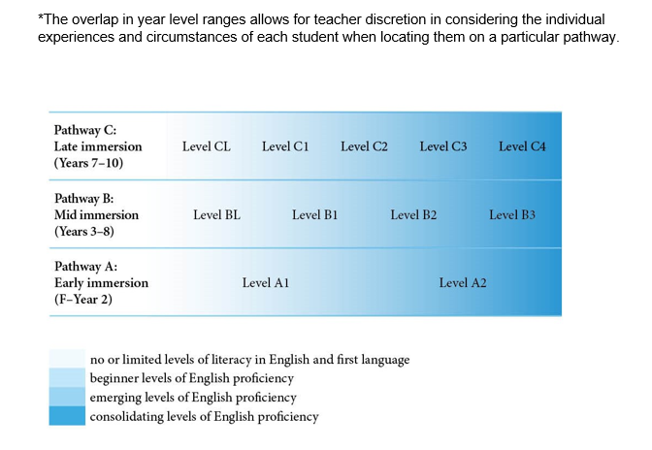
F-10 EAL Pathways

Slide 10
Pathways and levels
The English as an Additional Language (EAL) curriculum sets out what students are expected to learn and is designed as a continuum of learning structured as three pathways. The pathways are presented in scope and sequence charts to support teachers to easily see the progression and assist in planning teaching and learning programs to meet the diverse needs of students.
These charts include the content descriptions and achievement standards. It is advised that they are read in conjunction with the introductory materials and the level descriptions in the curriculum.
EAL Scope and Sequence Pathway A.docx (106 KB)
EAL Scope and Sequence Pathway B.docx (116 KB)
EAL Scope and Sequence Pathway C.docx (118 KB)

Slide 11
Learning in EAL
Language Modes
Speaking and Listening
Reading and Viewing
Writing
Language Strands
Communication
Cultural and plurilingual awareness
Linguistic structures and features

Slide 12
Strands and sub-strands
Communication
Cultural understandings
Linguistic structures & features
Cultural & plurilingual awareness
Text structure and organisation
Plurilingual strategies
Grammatical patterns
Word knowledge
Grapho-phonics / phonology

Slide 13
Content descriptions
In each level ,mode, strand and sub-strand sits the content descriptions. These statements form the core of the curriculum. Content descriptions include the knowledge and skills; the intended content that is the major focus of the mode and strand to be taught. These statements inform the learning objectives teachers are expected to teach and students are expected to learn.

Slide 14
Content descriptions
Level
Level B2
Writing
Linguistic structures and features
Text structure and organisation
Use headings and text formats appropriate to the task
Write simple paragraphs with a logical sequence of sentences
Use simple time sequence markers and pronoun references to connect ideas in a text
Language mode
Strand
Sub-strand
Content descriptions
(Skills / actions that are teachable)

Slide 15
Content descriptions
Use heading and text formats appropriate to the task.
Write simple paragraphs with a logical sequence of sentences.
Use simple time sequence markers and pronoun references to connect ideas in a text.

Slide 16
Elaborations
Elaborations provide more explicit direction to teachers as to ways in which the content descriptions can be elaborated upon to highlight teaching and learning activities that can be undertaken to meet the learning outcomes of that content description.
They are not all-inclusive. They can be added to. They form prompts for the application of the teaching and learning from the content description into the classroom.

Slide 17
Elaborations
An example of a content description and the elaborations to support it from the B2 scope and sequence chart
B2 Writing
Linguistic structures and features
Text structure and organisation
Content Description: Write simple paragraphs with a logical sequence of sentences (VCEALL388)
Elaborations:
grouping sentences about the same topic into a paragraph
organising sentences using a simple sequence, for example chronological order of events or strong to weak arguments
using key words to write a simple topic sentence that states the main idea of the paragraph

Slide 18
Elaborations
An example of a content description and the elaborations to support it from the C2 scope and sequence chart
C2 Speaking and Listening
Communication
Content description: Negotiate interactions with reliance on an attentive conversation partner (VCEALC610)
Elaborations:
expressing complex thoughts and feelings in familiar situations
seeking assistance or feedback from speech partners to formulate or confirm corrected expressions
clarifying and elaborating on meaning by recasting and defining what has been said

Slide 19
Achievement standards
At the end of each level (A1, A2, BL, B1 etc …) of the EAL Curriculum in each of the modes, Speaking and Listening, Reading and Viewing and Writing sit the Achievement Standard. These statements sum up what students, who have reached the respective standard have learned and are able to demonstrate. They are virtually unchanged from the Achievement Standards from the English as an Additional Language (EAL) Companion to AusVELS, the predecessor to this curriculum. For example, the final sentence in the B2 Writing Achievement Standard states “They use more advanced software functions to write, edit and present their texts.”
When planning, identifying the learning accomplishments in the Achievement Standards will assist teachers to focus planning, teaching and learning to the stated outcomes.

Slide 20
Plurilingualism
Strand Cultural and plurilingual awareness
Sub-strand: Plurilingual strategies
Plurilingual awareness’ refers to understanding that people can use knowledge of more than one language to learn and communicate.
It involves understanding that all languages spoken or used by a person form a repertoire that can be drawn upon, rather than seeing proficiency in one language as having no impact on capacity to learn another.
Teachers can gain familiarity and apply the opportunities that the Content descriptions and elaborations provide within the plurilingual strategies sub-strand. However it is not an area of the curriculum that is referenced in the Achievement Standards and as such it is not assessed.

Slide 21
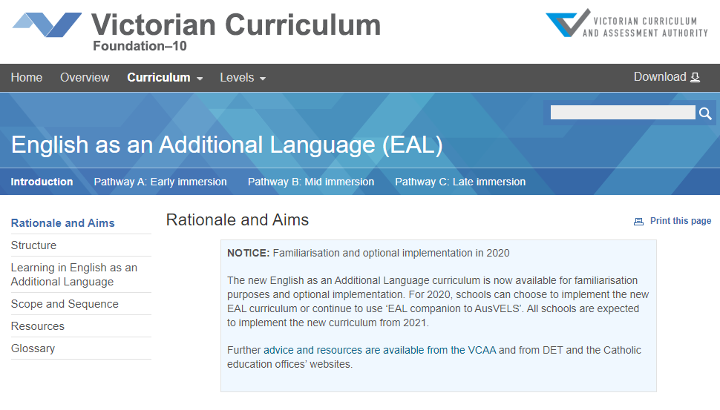
Navigating the EAL Curriculum
Structure
Taking a look at the Structure tab we see the articulation of the pathways. The EAL curriculum is organised by pathways, language modes and strands.
Pathway A: Early immersion (Foundation –Year 2)
Pathway B: Mid immersion (Years 3-8)
Pathway C: Late immersion (Years 7-10)

Slide 22
Scope and Sequence Pathway B
Presents the four B levels BL-B4 horizontally across the three modes so it can be read as a continuum
Starts with modes-(following the arrows to your right) Speaking and Listening, then Reading and Viewing, then Writing
List the Strands within each mode e.g. (1) Communication (2) Cultural and plurilingual awareness and (3) Linguistic structures and features
Lists the sub-strands under each strand. Looking at B level Writing the sub-strands are Cultural understandings, Plurilingual strategies, Text structure and organisation, Grammatical patterns, Word knowledge and Grapho-phonics
Within each sub-strand are Content descriptions e.g. B3 Writing, Linguistic structures and features, Grapho-phonics: e.g. Spells most words accurately, drawing on a range of strategies but with some invented spelling still evident
The final row at the end of each of the modes contains the Achievement Standard statement for each level

Slide 23
Accessing the Pathways tabs
These options allows us to apply filters and access views to refine or expand our search.
The first view options opens the curriculum with the provision of a description of the level. The modes are placed alongside each other. Content description across the modes can be seen on this view. (In the EAL curriculum the mode Speaking and Listening is placed first, followed by Reading and Viewing and then Writing. This is to reflect the natural order of language acquisition in L1). In descending order the strands and sub-strands sit below each mode. The achievement standards are listed for each mode at the end of each level.
The second view option reorders the same content but by level with the modes listed in descending order. The content descriptions can be seen across the levels in this view.
The final view option is ordered by levels highlighting the content descriptions and the elaborations.

Slide 24
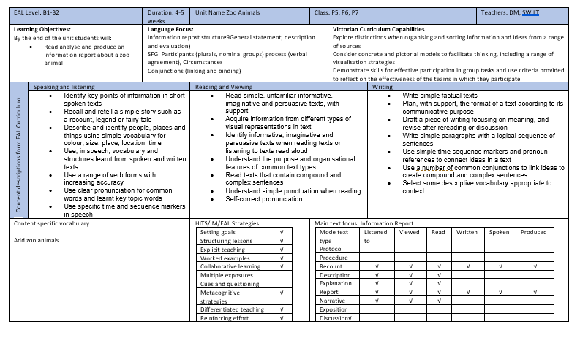
Applying the EAL curriculum for Planning
Unit Planning Document

Slide 25
Content Descriptions from new EAL Curriculum
Content descriptions form EAL Curriculum | Speaking and listening
 | Identify key points of information in short spoken texts Recall and retell a simple story such as a recount, legend or fairy-tale Describe and identify people, places and things using simple vocabulary for colour, size, place, location, time Use, in speech, vocabulary and structures learnt from spoken and written texts Use a range of verb forms with increasing accuracy Use clear pronunciation for common words and learnt key topic words Use specific time and sequence markers in speech

Slide 26
Developing learning intentions
Content Description:​
A1 Speaking and Listening
Communication
Content description: Participate in simple and familiar songs, rhymes and chants​
Elaborations​
Reciting familiar rhymes, songs with actions or lists of words such as days of the week or colours of the rainbow. ​
Rehearsing formulas or short exchanges based on models, such as ‘Hello, what is your name?, My name is..)​
Role-playing popular stories or songs, for example, ‘Little pig, little pig, let me in’.

Slide 27
Developing learning intentions
Activity:
Develop a learning intention from the Content description and elaborations listed in the previous slide.
Learners will be able to………………………..
Learners will understand………………………
Learners will know………………………………

Slide 28
Lesson proforma
Using the EAL curriculum to complete a lesson plan: (an approach)
1. Determine the Strands/Sub-strands/Content Descriptions:​
2. Develop the Learning Intention ​
3. Select a Teaching and Learning activity​
4. Develop the Success Criteria​
5. Outline the lesson plan (Setting Goals, Tuning in, Explicit Teaching, Whole Class/Pair/Independent Work, Differentiation​)
6. Feedback/Summing Up​
7. Assessment

Slide 29
Using success criteria
Teachers are able to use success criteria to make a judgement as to whether the learner has been able to demonstrate mastery over a learning intention that has been developed from a Content description.
Dynamic assessment , conferencing, evidence of student work samples are part of a range of assessments teacher use to measure learning.
All ELS/C have planning proformas, assessment practices and processes at a local level.
The best way to gain familiarity with his new curriculum is to read it, collaborate with your colleagues to learn to navigate around it and apply it in your planning and assessment.

Slide 30
Resources
Additional resources to support the curriculum can be found in the following links.
Victorian Curriculum F–10 EAL resources (VCAA)
Via this link you will gain access to an extensive glossary, a Language and Learning interview( to be administered on enrolment to build a socio-linguistic profile) and a number of sample progressions through the pathways and levels of the EAL Curriculum.

Slide 31
Curriculum Planning Self Assessment tool
An additional resource available to all schools is the curriculum planning self assessment tool which looks at whole-school curriculum planning involving four interrelated areas.
This can be found Curriculum Planning Resource (VCAA)

Slide 32
Questions
Responding to questions posed in the chat

Slide 33
Contact
For any questions concerning the EAL curriculum, please contact :
Kellie Heintz, EAL Curriculum Manager, VCAA
Kellie.Heintz@education.vic.gov.au

