Slide 1
Victorian Curriculum: F-10 English as an Additional Language (EAL)
Tuesday 28 July 2020
Kellie Heintz, EAL Curriculum Manager

Slide 2
Acknowledgment of Country
In recognition of Aboriginal and Torres Strait Islander people’s spiritual and cultural connection to country, we acknowledge the traditional custodians of the Kulin Nations. We acknowledge the continued care of the lands and waterways over generations and celebrate the continuation of a living culture that has a unique role in this region.
We pay our respects to Elders past, present and emerging, for they hold the memories, traditions, culture and hopes of all Aboriginal and Torres Strait Islander peoples across the nation and hope they will walk with us on our journey.

Slide 3
Contents
This presentation will cover:
the importance of the new Victorian Curriculum F-10 EAL
the responsibility of teachers
unpacking the curriculum
familiarisation with the website and resources
plurilingualism as a new addition

Slide 4
2021
In 2021, the Victorian Curriculum F-10 EAL will be mandated for implementation in both government and Catholic schools.
Independent schools will be guided by their school.

Slide 5
Why a new EAL curriculum?
To establish EAL as a standalone curriculum in its own right
To provide a consistent curriculum structure across all of the Victorian Curriculum learning areas
To recognise the diverse backgrounds and learning experiences of EAL students in schools across Victoria

Slide 6
Why a new EAL curriculum?
To support the specific needs of EAL students
To recognise that EAL students might know more than one language, and that they bring with them a linguistic repertoire in that language, that can be used to support the learning of English

Slide 7
A curriculum across all learning areas
The Victorian Curriculum F-10 EAL:
recognises that students need to access and to demonstrate learning in all learning areas

Slide 8
Teacher responsibility
In general, teachers will need to:
be aware of EAL learners in their classrooms
have a sense of the proficiency levels of their EAL students
unpack content-specific language for EAL students
be able to plan for and support the language learning of EAL students in order to support their understanding of the different content

Slide 9
What does this mean for schools?
The whole school is responsible for planning and implementing the new EAL curriculum.
The expertise of specialist EAL teachers needs to be drawn upon.
Specialist EAL teachers will need time to work with teachers of EAL students.

Slide 10
Collaboration
School leaders will need to consider how the implementation of the EAL curriculum impacts on the whole-school EAL approach. This may mean changing:
how all teachers of EAL learners work together
who is involved in EAL planning
who has oversight of the EAL program
Opportunities for specialist EAL teachers to work collaboratively with generalist primary teachers and/or secondary subject teachers will also need to be considered.
For government schools, the EAL curriculum school implementation guide is aligned to the FISO Improvement, and provides detailed recommendations on how to implement the EAL curriculum using a whole-school approach.

Slide 11
What might this look like?
The specialist English or EAL teacher/s meet with classroom teachers and subject teachers of EAL students to:
review student assessment and identify a student’s initial pathway on the EAL curriculum
refer to the EAL curriculum for examples of appropriate language learning for that pathway
consider how the content of a specific learning area may be adapted and scaffolded to support the student’s access to language in that subject

Slide 12
Secondary English/EAL teachers
Secondary English or EAL teachers report on the English language proficiency of their EAL students using the EAL curriculum.

Slide 13
Secondary school subject teachers
Teachers who are not EAL specialists do not need to report on the English language proficiency of their EAL students.
Teachers report on their learning area content, as is the current practice.

Slide 14
Unpacking the curriculum
The Victorian Curriculum F-10 EAL is:
organised by pathways, language modes, strands and sub-strands.

Slide 15
The pathways
The Victorian Curriculum F-10 EAL is:
a continuum structured as three EAL pathways (A, B, C).
Each pathway describes a different stage of English-language learning (early, mid and late), and each pathway is divided into different levels of language learning (A1, A2, BL, B1, B2, B3, CL, C1, C2, C3, C4).

Slide 16
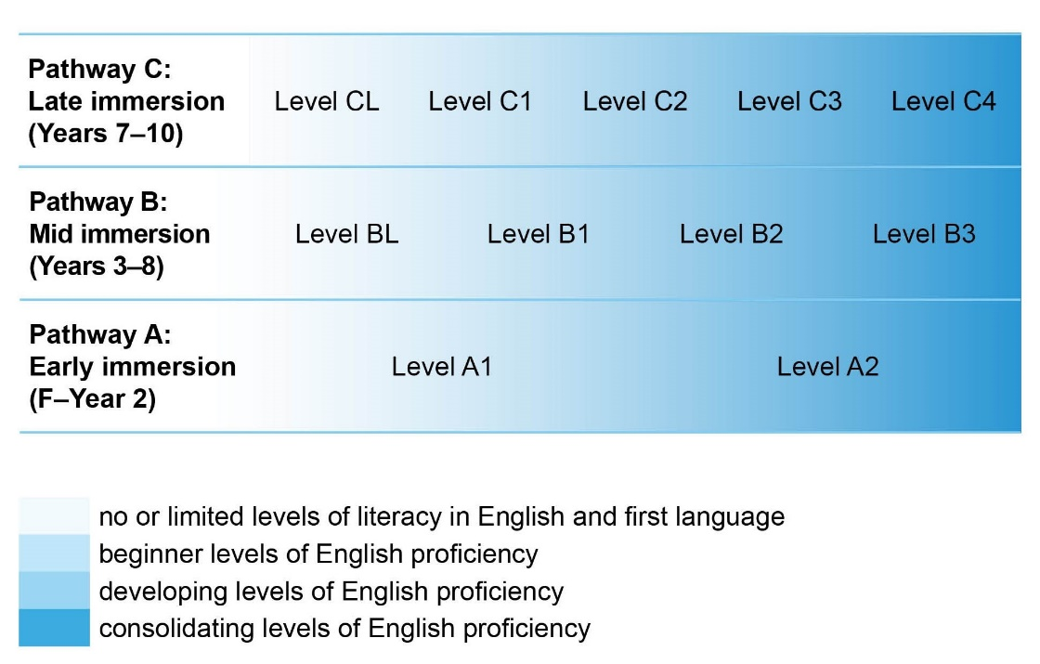
The pathways

Slide 17
Understanding the pathways
EAL Pathway A: Early immersion (Foundation–Year 2)
Early immersion language learners typically develop their literacy skills through experiences in the school context. Those who have had some experience of formal preschool or school will more readily adapt to the school setting.
A student located on EAL Pathway A may have some experience of formal learning in their home language or other languages and some experience of informal prior learning.
EAL Pathway A includes two levels of English-language learning: Level A1 and Level A2. Those with little or no experience of English begin at A1; those with some experience may begin at A2. The progress within these levels equates to the rates of progression expected in Foundation–Year 2.
Generally students who enter Foundation are pre-literate, regardless of their language background, and hence there is no Level AL. EAL students who enter Foundation with minimal literacy in other languages will begin their early immersion in English at Level A1.

Slide 18
Understanding the pathways
EAL Pathway B: Mid immersion (Years 3–8)
Mid immersion language learners have experience of the social use of language, which they can use as they learn English at school. A student located on EAL Pathway B may have some experience of informal learning in their home language or other languages. Some have yet to experience formal schooling, while others may have experienced formal learning that is equivalent to their English-speaking peers. This may have been in their home language or other languages.
EAL learners with little or no English proficiency, fewer than two years of formal learning and minimal home literacy experience will begin this pathway at Level BL, before moving to Level B1. Learners with prior experience of formal learning but no proficiency in English begin at Level B1, and move through Levels B1, B2 and B3. The progress within these levels equates to the rates of progression expected in Years 3–8.

Slide 19
Understanding the pathways
EAL Pathway C: Late immersion (Years 7–10)
Late immersion language learners have a mature understanding of themselves and their relations with others in different social contexts, and are capable of understanding abstract ideas and relationships in their experience and learning about the world.
EAL learners without prior formal learning and with minimal home language literacy experience will begin this pathway at Level CL, before moving to the other levels. Learners with prior experience of formal learning but no proficiency in English will begin on Level C1 and move through Levels C1, C2, C3 and C4. The progress within these levels equates to the rates of progression expected in Years 7–10.

Slide 20
Language modes
Speaking & Listening
Reading & Viewing
Writing

Slide 21
Strands & sub-strands
Communication
Linguistic structures & features
Cultural & plurilingual awareness
Communication
Text structure & organisation
Grammatical
patterns
Phonology
Grapho-
phonics
Word
Knowledge
Cultural
understandings
Plurilingualstrategies

Slide 22
An online tour of the curriculum
https://victoriancurriculum.vcaa.vic.edu.au/english/english-as-an-additional-language-eal/introduction/rationale-and-aims

Slide 23
Plurilingualism
The ability of a person who has competence in more than one language to switch between them where necessary for ease of communication and learning. It is the interconnected knowledge of multiple languages.

Slide 24
Plurilingual strategies
Provide opportunities for EAL learners to:
draw on the linguistic and cultural repertoire of other languages to support the learning of both content and the English language

Slide 25
Plurilingual strategies
There are no content descriptions relating to plurilingual strategies, and they are not included in the achievement standards.
Teachers do not assess students’ achievement in other languages.

Slide 26
Plurilingualism at work
CL | C1 | C2 | C3 | C4
Distinguish spoken English from other languages and attempt to respond in English | Check understanding of classroom English by asking for clarification from other home language speakers | Ask for the translation of specific words from other home language speakers | Explain the home language meaning of unfamiliar English words and phrases to home language peers | Discuss a point of language
Use sentence patterns from home language to communicate ideas | Use home language to formulate speech in English and communicate ideas | Use home language resources to support use of English | Clarify in home language to check understanding | Use home language resources to develop English
Transfer some simple language structures to other contexts | Transfer knowledge from home language to English learning | Transfer academic and communication skills from home language to English | Talk about cultural differences related to communication | Compare and contrast different ways of communicating meanings in home language and English

Slide 27
Next session
Implementing the curriculum in primary settings
Thursday 30 July 2020
3.45pm-4.45pm
This session will focus on planning for implementation across a primary school, unpacking Pathways A & B and how to use the Language & Learning Interview.

Slide 28
Further sessions
4/8/20 | 3.45pm- 4.45pm | 3. Implementing the curriculum in secondary settings This presentation will focus on unpacking Pathways: B and C, and how to use the Language and Learning Interview to understand the needs of EAL students.
6/8/20 | 3.45pm-4.45pm | 4. Implementing the curriculum for newly arrived students in Language schools, centres and programs This presentation will focus on unpacking the EAL Pathways, and how to use the curriculum to meet the specific needs of newly arrived EAL students.
11/8/20 | 3.45pm-4.45pm | 5. Unpacking the curriculum for experienced teachers This presentation will focus on unpacking the curriculum for teachers familiar with the EAL Developmental Continuum.
13/8/20 | 3.45pm-4.45pm | 6. Unpacking the curriculum for new teachers of EAL students This presentation will focus on unpacking the curriculum for new teachers of EAL students.
13/10/20 | 3.45pm-4.45pm | 7. What is Plurilingualism? This presentation will explore plurilingualism and the ways it can be used to enhance the teaching of EAL students.
15/10/20 | 3.45pm-5.00pm | 8. Ways to assess and report on the curriculum This presentation will be conducted as a panel discussion. Representatives from DET and CEM will provide advice about the ways to assess and report on the curriculum in each sector.
20/10/20 | 3.45pm-4.45pm | 9. Suggestions about whole school curriculum planning This presentation will provide ideas and examples of the ways that schools may approach whole school curriculum planning for EAL.

Slide 29
Contact
For any questions concerning the EAL curriculum, please contact me:
Kellie Heintz, EAL Curriculum Manager, VCAA
Kellie.Heintz@education.vic.gov.au

