Slide 1
Formative Assessment –Collect evidence

Slide 2
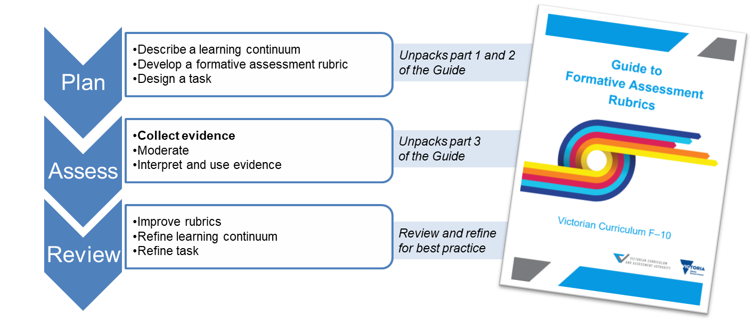
Overview

Slide 3
Purpose of this video
To discuss the collection of formative assessment data.​

Slide 4
Collecting evidence
Teachers collect evidence of student performance using the formative assessment task
Teachers record this evidence using the actions and quality criteria within the rubric

Slide 5
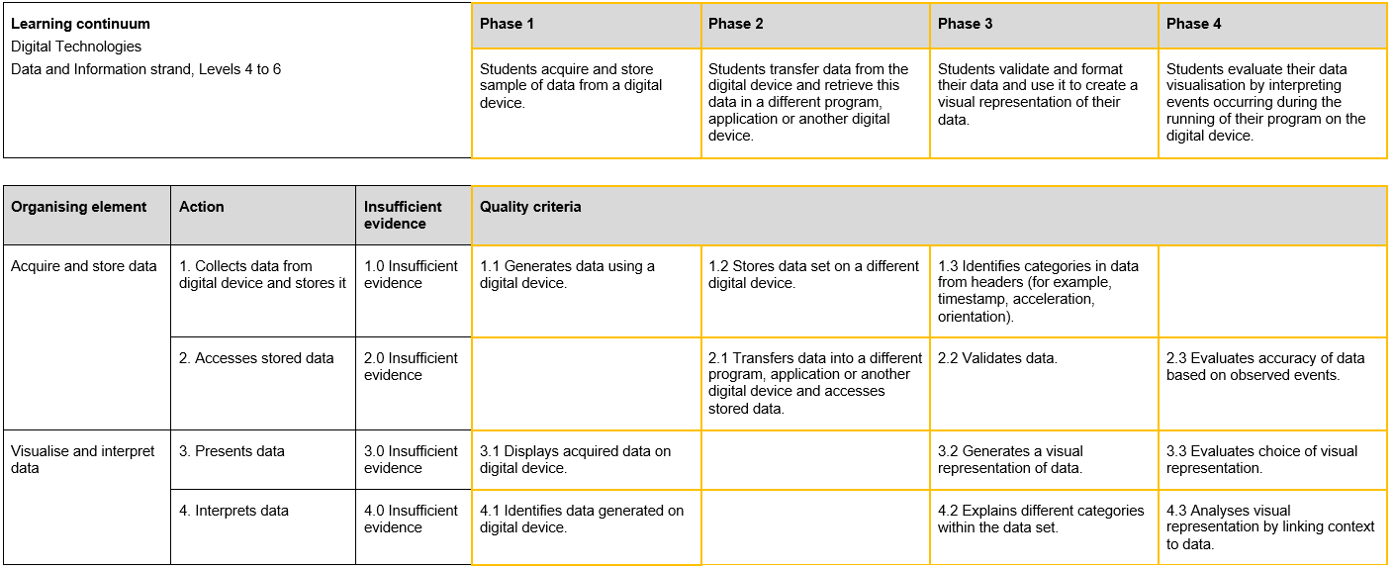
Making judgments

Slide 6
Making judgments
Use the rubric to guide judgments
Use evidence of observable behaviours
Make on-balance judgments
Judge on evidence gathered without assistance, unless explicitly stated in criterion

Slide 7
Recording evidence
Your chosen method of recording evidence of achievement should:
record evidence at criterion level
allow patterns to be identified across the class.

Slide 8
Rubric example

Slide 9
Next steps
You are now ready to:
select your recording method
assess your students.

