Slide 1
Chronology
Levels 7 to 10

Slide 2
Introduction
Provocation
Chronology in the curriculum context
Chronology in Victorian Curriculum History
Chronology in the continuum of learning
Towards the classroom
Examples of practice
Conclusion

Slide 3
Chronological thinking is at the heart of historical reasoning. Without a clear sense of historical time – time past, present, and future – students are bound to see events as one great tangled mess. Without a strong sense of chronol­ogy – of when events occurred and in what temporal order – it is impos­sible for students to examine relationships among them or to explain historical causality. Chronology provides the mental scaffolding for organizing historical thought.
Stephane Levesque, Thinking Historically: Educating Students for the Twenty-First Century
Notes:
Levesque, S 1971, Thinking Historically: Educating Students for the Twenty-First Century, University of Toronto Press, Toronto, p. 78

Slide 4
Chronology in Victorian Curriculum History

Slide 5
Victorian Curriculum History
Skill/Concept
Historical Knowledge
Achievement Standard
Learning in History

Slide 6
Learning in History
‘Chronology involves the arrangement of events in order of time. However, the sequencing of events is not an end in itself. It allows students to understand the sequence and flow of events and identify patterns of continuity and change, analyse cause and effect, distinguish between long-term causes and short-term triggers and provides the starting point and basis of explanatory narratives about the past.’
Victorian History Curriculum, Learning in History: Sequencing Chronology
Notes:
Victorian History Curriculum, Learning in History: Sequencing Chronology, https://victoriancurriculum.vcaa.vic.edu.au/the-humanities/history/introduction/learning-in-history

Slide 7
Achievement Standard
Levels 7 and 8 Achievement Standard
Students sequence events and developments within a chronological framework with reference to periods of time.
Levels 9 and 10 Achievement Standard
Students sequence events and developments within a chronological framework, and identify relationships between events across different places and periods of time.

Slide 8
Historical Concepts and Skills: Chronology
Levels 7 and 8
Sequence significant events in chronological order to analyse the causes and effects and identify continuities and changes (VCHHC097)
Describe and explain the broad patterns of change over the period from the Ancient to the Modern World (VCHHC098)
Levels 9 and 10
Sequence significant events in chronological order to support analysis of the causes and effects of these events and identify the changes they brought about (VCHHC121)
Analyse and evaluate the broad patterns of change over the period 1750–present (VCHHC122)

Slide 9
Connections
Chronology connects with:
other Historical Concepts and Skills
historical content knowledge
instructional terms.
Levels 7 and 8
Chronology
Sequence significant events in chronological order to analyse the causes and effects and identify continuities and changes (VCHHC097)
Describe and explain the broad patterns of change over the period from the Ancient to the Modern World (VCHHC098)

Slide 10
Connections: your turn
Levels 9 and 10
Sequence significant events in chronological order to support analysis of the causes and effects of these events and identify the changes they brought about (VCHHC121)
Analyse and evaluate the broad patterns of change over the period 1750–present (VCHHC122)
Identify:
other Historical Concepts and Skills
historical content knowledge
instructional terms.
Notes:
Other Historical Concepts and Skills: Historical Significance; Change and Continuity
Historical content knowledge: period 1750–present
Instructional terms: sequence, analyse and evaluate

Slide 11
Continuum of learning
Levels 5 and 6
Levels 7 and 8
Achievement Standard
Students sequence events and people (their lifetime) in chronological order, and represent time by creating timelines.
Historical Concepts and Skills
Sequence significant events and lifetimes of people in chronological order to create a narrative to explain the developments in Australia’s colonial past and the causes and effects of Federation on its people (VCHHC082)
Achievement Standard
Students sequence events and developments within a chronological framework with reference to periods of time.
Historical Concepts and Skills
Sequence significant events in chronological order to analyse the causes and effects and identify continuities and changes (VCHHC097)
Describe and explain the broad patterns of change over the period from the Ancient to the Modern World (VCHHC098)
Levels 9 and 10
Achievement Standard Students sequence events and developments within a chronological framework, and identify relationships between events across different places and periods of time.
Historical Concepts and Skills
Sequence significant events in chronological order to support analysis of the causes and effects of these events and identify the changes they brought about (VCHHC121) Analyse and evaluate the broad patterns of change over the period 1750–present (VCHHC122)
Notes:
Discussion question – How can we design a task that can scaffold for students operating over a wide range of achievement levels? What would that look like?

Slide 12
Sequencing Chronology and Historical Knowledge
Historical Knowledge
Where is chronology explicit?
Where is chronology implied?
Where is chronology necessary?
Where is there an opportunity for chronology?
Use this structure to break down the knowledge content descriptions to understand the application of the skill.

Slide 13
Sequencing Chronology and Historical Knowledge
Australia at war (1914–1945): World War I
Causes of World War I, the reasons why men enlisted to go to war, and how women contributed in the war effort (VCHHK139)
Significant places where Australians fought and explore their perspectives and experiences in these places (VCHHK140)
Effects of World War I, with a particular emphasis on the changes and continuities brought to the Australian home front and society (VCHHK142)
Significance of World War I to Australia’s international relationships in the twentieth century, with particular reference to the Britain, the USA and Asia (VCHHK143)
Different historical interpretations and contested debates about World War I and the significance of Australian commemorations of the war (VCHHK144)
Notes:
This is an example of the Historical Knowledge for Levels 9 and 10.
What elements of the Historical Knowledge of the topic Australia at War (1914–1945): World War I require students to apply the skill of sequencing chronology?

Slide 14
Towards the classroom

Slide 15
Towards the classroom
Levels 7 and 8
Students think about chronological sequencing on several levels. They encounter big picture ideas such as the history of human civilisation and the contribution of archeology to our understanding of the past.
Sequencing chronology helps students understand the patterns and commonalities across the societies they investigate and consider their legacies in the present day. For their study of a specific society, students use key dates to understand and create narratives about leadership, architectural features, conflicts, the spread of religious ideas, trade and exploration.
Students are introduced to the conventions of reading and writing about chronology. This includes the use of BCE (Before Common Era) and CE (Common Era), and terms such as the ‘20th century’ to describe the period from 1900 to 2000. They also become adept at applying terms to describe time, such as long term and short term.

Slide 16
Towards the classroom
Levels 9 and 10
At this level, sequencing chronology underpins students’ sophisticated historical thinking. Students are placing events in order so that they can interrogate that order for meaning – to chart patterns of change, to identify long-term causes and effects, to judge whether an event was truly significant.
Sequencing chronology ensures students do not perceive history as an endless series of fragmented vignettes but as a rich and complex narrative that can be understood. It prevents students from falling into simple errors about the flow of causation and influence. It allows students to see the deep tides of change that produce ripples in different countries and historical periods.

Slide 17
Indicative examples
By the end of Level 8:
By the end of Level 10:
students use timelines to identify patterns of change over time
students use timelines to identify sequences of causation and consequences
students explain broad patterns over large time periods in a written response
students use timelines to identify significant events in the life of key individuals.
students use timelines to map broad patterns of change over time
students use timelines to link sequences of causation and consequences to historical events
students demonstrate an understanding of the sequence of events in structured written responses
students use timelines to identify significant events in the life of key individuals.

Slide 18
Language of Chronology
Date
Timeline
Circa
Prehistory
Annotated
Chronology
Before
Long term
Short term
Epoch
Century
Decade
Sequence
Year
Time
Order
Relationship
Parallel
Connection
Causes
Consequences
After
Next
Earlier
Notes:
Language of Chronology
The language of Chronology becomes increasingly complex as students engage with longer time periods and begin to apply the conceptual thinking of Chronology to Change and Continuity and Cause and Effect.

Slide 19
Classroom ideas
Levels 7 and 8
Levels 9 and 10
Create an enhanced timeline and annotate it to identify patterns over time.
Write a piece of historical fiction that sequences events in their correct order.
Play a mix-and-match game where students must sequence events in the correct order.
Create an enhanced timeline and annotate it to identify changing patterns over time.
Produce a structed piece of writing that demonstrates an understanding of chronology.
Create an infographic that identifies relevant events.

Slide 20
Example of practice
Levels 7 and 8

Slide 21
Activity
2
Key question: How can we use timelines to understand the past?
Activity:
Use the following slides and Levels 7 and 8: Chronology – Student Handout to assess your students’ understanding of chronology.

Slide 22
Sequencing Chronology
3
Notes:
Students should be able to put historical events in the right order. As students progress, it means that they understand that the order of events can teach us something about:
cause and effect
continuity and change
the flow of a historical narrative.

Slide 23
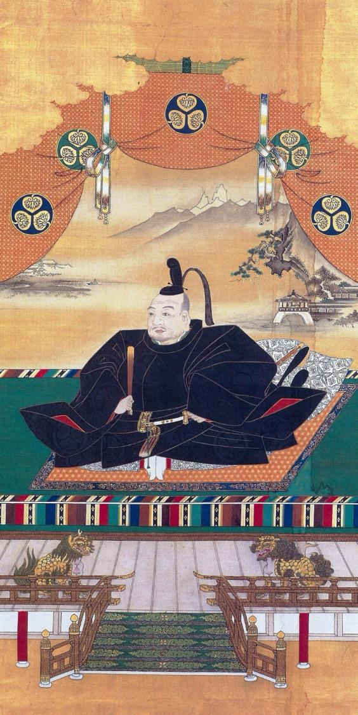
4
A chronology of Japan under the Shoguns
(c.794–1867)
Notes:
Please refer to the Levels 7 and 8: Chronology Student Handout and Teacher Notes.
Slide 6 is a simplified example of a timeline to help your students answer Question 1 on the handout.
Timelines can be made using shapes and text boxes in Word documents and PowerPoint presentations. They can also be made in an Excel spreadsheet.
Differentiated learning
Support: Students could complete the handout in pairs or as a small group under teacher guidance.
Extension: Students could use their accumulated knowledge to debate with other students whether ‘Japan under the Shoguns was a time of great change’.
Image attribution
Image Title: Portrait of Shogun Tokugawa Ieyasu
Creator: Kanō Tan’yū (1602–1674 AD)
Source: https://commons.wikimedia.org/wiki/File:Tokugawa_Ieyasu2_full.JPG
License: This work is out of copyright

Slide 24
We will need to understand the meaning of these words to learn about Japan under the Shoguns
5
empire
daimyo
shogun
sakoku
divine wind
shogunate
imperial rule
civil war
emperor
feudalism
dynasty
sovereign
Notes:
Your students will need to understand these words in order to engage fully with this activity. After finding out which words the students already understand, you might wish to ask the students to look up these words and share their meanings. These words could then be added to a word wall or a shared glossary on their LMS.
empire – a large area under one political rule or a group of territories under one rule
emperor – the ruler of an empire
feudalism – a society that is based upon the holding of land and power by a few individuals in exchange for protection and the giving of service or labour by the many
daimyo – a warlord or powerful Japanese feudal lord
shogun – an all-powerful military ruler of Japan with an emperor as a figurehead ruler
sakoku – Japanese foreign policy that forbade any Japanese person from leaving Japan or any foreigner entering it; the ‘locked country’ policy
divine wind – name given to the typhoons that saved Japan from invasion by the Mongols, twice
shogunate – the period of time when Japan was ruled by a Shogun
imperial rule – the periods of time when the emperor had complete power and ruled Japan
civil war – when groups of people from within the same country fight for power and control
dynasty – a line of rulers from the same family
sovereign - a king or queen

Slide 25
6
Emperor Go-Daigo overthrows Kamakura shogunate
Shogun Yoshimitsu unifies Japan again
Warring States period begins
Minamoto no Yoritomo becomes shogun
1185 AD
1333 AD
1337 AD
1392 AD
1467 AD
Emperor Go-Daigo is challenged by Muromachi shogunate – civil war follows
Notes:
This is a simplified example of a timeline to help your students answer Question 1 on the handout.

Slide 26
Example of practice
Levels 9 and 10

Slide 27
Activity
2
Key question: How can timelines help us consider new links between events?
Activity:
Use the following slides to assess your students’ understanding of chronology.

Slide 28
Vocabulary
3
Activist
Segregation
Interracial
Reconciliation
Ku Klux Klan
Deep South
CORE
Freedom Rides
SNCC
Fellowship of Reconciliation
SAFA
Reserve
Notes:
Vocabulary
Your students will need to understand these words in order to engage fully with this activity. After finding out which words the students already understand, you might wish to ask the students to look up these words and share their meanings. These words could then be added to a word wall or a shared glossary on their LMS.
Activist – a person who actively advocates for social or political change
Segregation – the separation of one group from another
Interracial – involving two or more races
Reconciliation – becoming friends again
Ku Klux Klan – a hate group, founded in 1915, whose aim is to restore and maintain the supremacy of white people
Deep South – the southern states of the USA most dependent on plantations and slavery in the early history of USA, it usually includes the states of Georgia, Alabama, South Carolina, Mississippi and Louisiana
CORE – founded in 1942, The Congress of Racial Equality was an African American civil rights group
Freedom Rides – bus rides held in the USA in 1961 to protest segregated bus terminals and in Australia in 1965 to bring attention to the poor living conditions of Aboriginal people
SNCC – Student Nonviolent Coordinating Committee; a civil rights group formed to give young African Americans a voice in the civil rights movement, they quickly became more radical in their ideas
Fellowship of Reconciliation – was founded in 1915 in the USA as a nonviolent protest group
SAFA – an activist group of Sydney University students called Student Action for Aboriginals
Reserve – a government-run settlement for Indigenous Australians

Slide 29
Sequencing Chronology
4
Notes:
Students should be able to put historical events in the right order. For more advanced students, it means that they understand that the order of events can teach us something about:
cause and effect
continuity and change
developing a historical narrative.
From the Victorian Curriculum F–10
Levels 9 and 10: Sequencing chronology
Content descriptions
Sequence significant events in chronological order to support analysis of the causes and effects of these events and identify the changes they brought about (VCHHC121)
Analyse and evaluate the broad patterns of change over the period 1750–present (VCHHC122)

Slide 30
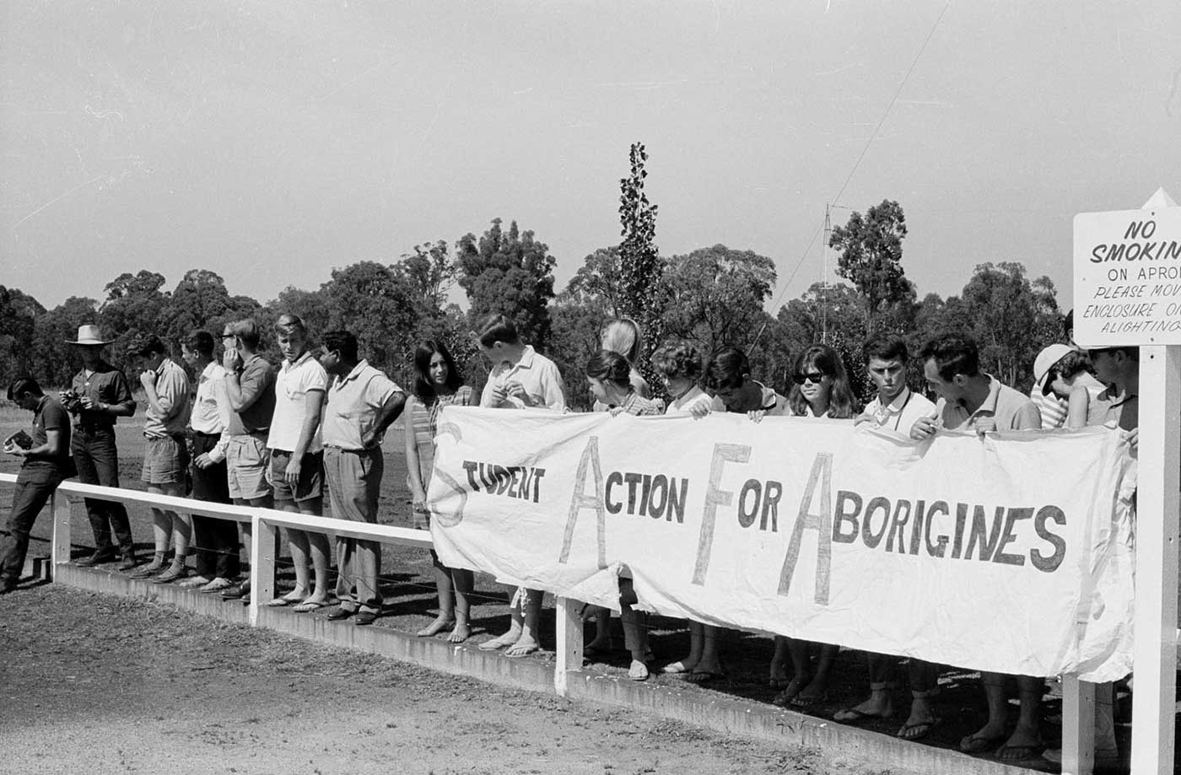
5
Sequencing Chronology:
The Freedom Rides
Notes:
Please refer to Levels 9 and 10: Chronology – Student Handout.
Differentiated learning
Support: Students could complete the activity sheet in pairs or as a small group under teacher guidance.
Extension: Students could use their timelines and further research to identify the changes brought about by these events.
Image attribution
Title: Student Action for Aborigines, University of Sydney
Creator: Unknown
Source: Mitchell Library, State Library of New South Wales and Courtesy SEARCH Foundation.
License: CC BY 4.0

Slide 31
6
As historians, it is important to know the order of events as that can help us come to a greater understanding of what occurred, evaluate its significance or impact, and identify links between events.

Slide 32
7
Timeline activity:
What new things do we learn by considering the sequence of events?
What new questions or analysis are inspired by understanding the sequence of events?
Notes:
Teacher notes
Provide your students with Levels 9 and 10: Chronology – Student Handout and ask them to complete the following task:
Read the handout and highlight the significant dates and events.
Create a single timeline that includes the key dates for each Freedom Ride on either side of the timeline.
Ask your students to describe what the timeline, presented in this way, helps them understand about the Freedom Rides, including their causes and effects.
Ask each student to think of two historical questions that occur to them as a result of analysing this timeline. Discuss these questions as a group.
For homework, ask students to research the answers to their own historical questions and add them to a shared, digital version of the timeline.

Slide 33
Conclusion

Slide 34
Discussion points
How often do your students return to creating timelines or tables to help them understand the period they are studying?
Do you ask students to describe the criteria they are using to decide which events or turning points are significant enough to be included in their timelines?
Does your class ‘play’ with different modes and presentation formats for timelines, analysing which are most useful for a particular investigation?
What is the most powerful, informative timeline that you have ever developed with your students?
Once a timeline is complete, do you press your students to analyse what light it shines on the narrative?
How can we ensure that student-produced timelines are rich tasks and not just a series of dates and facts taken from Wikipedia?
How do we design activities that cater for a wide range of learners?
Notes:
Individually or in groups, use these questions to reflect on your teaching. How do you approach teaching the concept of chronology? How might you approach it differently?

Slide 35
Reflection activity
Use the following thinking routine to reflect:
What excites you about this idea?
What do you find worrisome?
What else do you need to know?
What is your current stance or opinion?

