Slide 1
Module 1: Respectful Relationships in the Victorian Curriculum The Victorian Curriculum F–10: Health and Physical Education and Personal and Social Capability, including Respectful Relationships

Slide 2
Respectful Relationships
Respectful Relationships education is the holistic
approach to school-based, primary prevention
of gender-based violence.
It uses the education system as a catalyst for
generational and cultural change by engaging
schools, as both educational institutions and
workplaces, to comprehensively address the
drivers of gender-based violence and create a
future free from such violence.
Our Watch Victoria, Respectful Relationships Education in Schools: Evidence Paper, December 2015

Slide 3
Why teach Respectful Relationships?
Royal Commission into Family Violence:
Evidence is clear that a contributor to gender-based and family violence is strict adherence to gender roles, and gender stereotyping. The aim of Respectful Relationships is to change these attitudes in young people, so that as they enter into intimate relationships they are less likely to engage in gender-based or family violence.
Respectful Relationships as school-based primary prevention has been a strong focus of the Royal Commission into Family Violence.
Royal commission into Family Violence, 2015, recommendation 189

Slide 4
Why teach Respectful Relationships?
There are five powerful reasons to focus efforts on young people:
Adolescence is a crucial period in terms of the formation of respectful, non-violent relationships.
Many children and young people experience violence in their homes.
Young people are already being subjected to, and perpetrating, violence themselves.
There is already a degree of tolerance for violence against girls and women.
Violence prevention among children and youth has been shown to work.
Source: DEECD 2009, Respectful Relationships Education

Slide 5
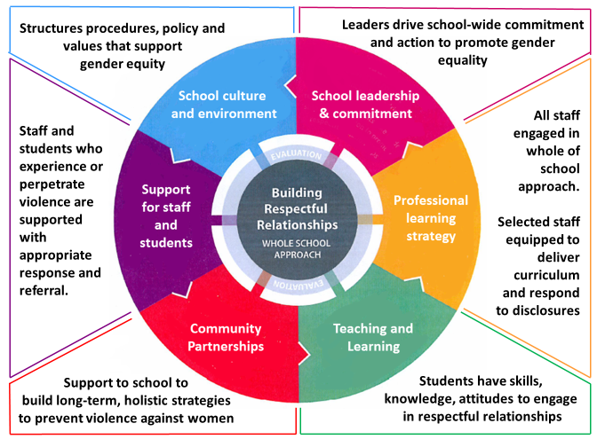
Whole-school approach

Slide 6
Curriculum planning
Schools can decide how to structure their teaching and learning program. Content descriptions across the learning areas and capabilities can be combined to create teaching and learning programs.
Schools will design teaching and learning programs to:
reflect local resources, expertise and contexts, and allow for specialisation and innovation
ensure every student has the opportunity to learn the knowledge, understandings and skills defined in the curriculum

Slide 7
Curriculum planning
Respectful Relationships
A teaching and learning program for respectful relationships may include:
the importance of a range of social relationships, including within families, peer groups and the community
identifying and managing emotional responses in a range of contexts
developing knowledge and skills to promote safe and respectful relationships.

Slide 8
How will Respectful Relationships fit?
Audit what is already being taught
Completing a curriculum audit will ensure that what is being taught can be identified
Missing elements and ‘double-ups’ will also be identified

Slide 9
Where can Respectful Relationships be taught?
Respectful Relationships can be taught in many areas of the school:
Health and Physical Education
Personal and Social Capability
English
Humanities
Legal Studies
Media Studies
Pastoral care groups

Slide 10
Curriculum connections
Learning in Personal and Social Capability is strongly connected to many other areas of the curriculum, especially those that explore human relationships.
Health and Physical Education, in particular, enables students to develop knowledge of and recognition of personal qualities, awareness of identity, and the establishment and maintenance of respectful relationships.

Slide 11
Curriculum areas
Respectful Relationships can be taught in other subject areas and in pastoral care.
By teaching respectful relationships across multiple curriculum areas, the whole-school approach is supported and the benefits are maximised.
Go to the FAQ on the VCAA website for examples of where Respectful Relationships could be included in different curriculum areas and its place in pastoral care.

Slide 12
To summarise
Respectful relationships is a whole school approach to tackling violence, particularly gender-based violence.
A whole school approach will adopt the 6 focus areas shown on slide 5
Integration into the curriculum in different subject areas will maximise the impact.
All schools should map the curriculum and then include respectful relationships material as best suits their community.

Slide 13
Heather Kearle VCAA Specialist Teacher Health Education and Personal and Social Capability, including Respectful Relationships

